Slide 1
115-2 & 116-1
Outbound Exchange
Applications Now Open
Step Outside ISU, See the World
Spring 2027 (115-2) & Fall 2027 (116-1) Exchange Terms
Application Deadline: Sep 2 (Wed)
1 / 9

Slide 2
Why Study Abroad?
Good to know: at most partner universities, exchange students don't pay separate tuition — you only pay ISU's regular tuition.
Credit transfer — stay on track to graduate
1
Apply for an ISU scholarship
2
Choose from our global partner universities — study abroad at a fraction of the cost
3
ISU Global Mobility Center
2 / 9

Slide 3
Where Do ISU Students Go?
Top Destination Countries
Japan
China
UK
France
Korea
Finland
Popular Partner Universities
Nottingham Trent University, UK
Teikyo University, Japan
Komazawa University, Japan
Obirin University (Japan) / Gachon University (Korea) /
Xiamen University (China)
Good to know: most of our partner universities offer courses taught fully in English. Check each school's official website or contact the GMC to explore your options. For Japan, the GMC has already compiled a list of fully English-taught courses on the next page.
ISU Global Mobility Center
3 / 9

Slide 4
Japan's Fully English-Taught
Courses — by College
Find your college below to see matching Japanese partner universities.
ENG
College of Engineering
Shibaura Institute of Technology (Mostly UG) / Ehime (Grad) / Gunma (Mostly Grad) / Nagasaki (UG)
TEC
College of Intelligent Technology
Shibaura Institute of Technology (Mostly UG) / Ehime (Grad) / Gunma (Mostly Grad)
MGT
College of Management
Shibaura Institute of Technology (Grad) / Nagasaki (UG) / Teikyo (UG) / Gunma (UG & Grad)
C&D
College of Communication & Design
Shibaura Institute of Technology (UG) / Teikyo (UG) / Nagasaki (UG)
INT
International College
Nagasaki University (UG) / Teikyo University (UG)
MED
College of Medicine
Shibaura Institute of Technology (UG) / Nagasaki (UG) / Ehime (Grad) / Gunma (UG & Grad)
MT
College of Medical Technology
Shibaura Institute of Technology (UG) / Nagasaki (UG) / Ehime (Grad) / Gunma (UG & Grad)
Courses can change at any time — please check each partner university's official website or contact the GMC to confirm.
ISU Global Mobility Center
4 / 9

Slide 5
Where Did Seniors Go? — By Department ①
Find your department below and see where past students went
College of Intelligent Technology
Dept. of Electrical Engineering Recently: Xiamen University
Dept. of Electronic Engineering Recently: Shibaura Institute of Technology
Dept. of Computer Science & Information Engineering Recently: Hunan University / Nottingham Trent University
Dept. of Data Science & Big Data Analytics Recently: Beijing Univ. of Posts & Telecom. / National Univ. of Singapore
Intelligent Technology English-Taught Program Recently: University of Regina / Shibaura Institute of Technology
College of Engineering
Dept. of Mechanical & Automation Engineering Most often: Vytautas Magnus University
Dept. of Chemical Engineering Recently: Chongqing University / South China Univ. of Technology
Dept. of Materials Science & Engineering Recently: Wuhan University / Gachon University
Dept. of Civil Engineering Recently: Tongji University / Tianjin University / Gachon University
College of Communication & Design
Dept. of Mass Communication Most often: Communication University of China
Dept. of Film and TV Most often: Chongqing University
Dept. of New Media Design Recently: Teikyo University / Wakayama University
College of Medicine
Dept. of Nursing Recently: Southern Illinois University
Dept. of Health Care Administration Most often: Gachon University
ISU Global Mobility Center
5 / 9

Slide 6
Where Did Seniors Go? — By Department ②
Find your department below and see where past students went
College of Management
Dept. of Industrial Management Most often: Sichuan University
Dept. of Business Administration Most often: Beijing Univ. of Posts & Telecom. / Wuhan University
Dept. of Finance Most often: Central University of Finance and Economics
Dept. of Accounting Recently: Xiamen University
Dept. of International Business Most often: Nanjing University
Dept. of Smart Tourism Services & Technology Recently: Xiamen University / NEOMA Business School
Dept. of Hospitality Management Most often: Jinan University
Dept. of Sport Technology & Leisure Management Most often: Shanghai Univ. of Finance and Economics
International College
Dept. of International Business Operations Most often: Shanghai Univ. of Finance & Econ. / Audencia Business School / ESCE Paris
Dept. of International Finance Most often: Audencia Business School
Dept. of International Tourism & Hospitality Most often: Woosong University
Dept. of Int'l Media & Entertainment Management Most often: D.A. Tsenov Academy of Economics / Univ. of Regina / Nottingham Trent Univ. / Woosong University
Dept. of International Communication & Applied English Recently: Gachon University / NEOMA Business School
Dept. of Applied Japanese Most often: Komazawa University / Teikyo University
ISU Global Mobility Center
6 / 9

Slide 7
Key Dates
For both 115-2 and 116-1 applicants
1
Now ~ Sep 2 (Wed)
Online application + documents to your department
2
Sep 2 ~ Sep 9
Department review, forwarded to GMC by Sep 9
3
Sep 16
Selection committee meeting
4
Sep 17 ~Sep 30
Results announced
ISU Global Mobility Center
7 / 9

Slide 8
Required Documents
Application form
Signed statement
Chinese & English transcripts (with class rank)
Language proficiency certificate
Supporting documents (if any)
All exchange students — 115-2 and 116-1 alike — are welcome to apply for an ISU scholarship. Contact the Global Mobility Center for details.
ISU Global Mobility Center
8 / 9

Slide 9
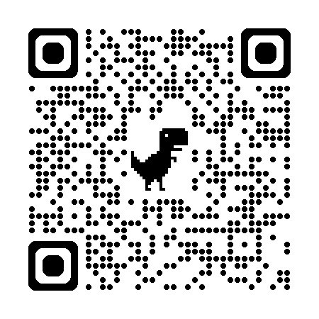
Start Preparing Now!
Online Application (Required)
forms.gle/3qNjFr5DK9NoEZ9G6
One application form for both 115-2 and 116-1
Form downloads: GMC website
Deadline: September 2, 2026 (Wed)
Questions? Global Mobility Center
isugmc@cloud.isu.edu.tw
9 / 9

